Slide 1
Architecture: Overview and Basic Logic Design
Jinyang Li

Slide 2
What we’ve learnt so far
Apps
Operating System
Software
Hardware
CPU
Memory
I/O
Logical Circuits, Flip-Flops, Gates, …

Slide 3

What we’ve learnt so far
tmp = a
a = b
b = tmp
High level language program
(e.g. C)
tmp = a
a = b
b = tmp
Assembly program
(e.g. x86)
tmp = a
a = b
b = tmp
Machine language program
(e.g. x86)
Software
Hardware

Slide 4
Today’s lecture plan
Computer Hardware Basic
CPU, memory, I/O devices
Moore’s law
Basics of Logic design

Slide 5
Computer hardware under the cover
Major components
of a computer
Input/Output devices
CPU
Memory

Slide 6


Computer hardware under the cover
Major components of a computer
Input/Output devices
CPU
Memory
1 rack-mountable server
Many racks full of rack-mountable servers
(data center)

Slide 7
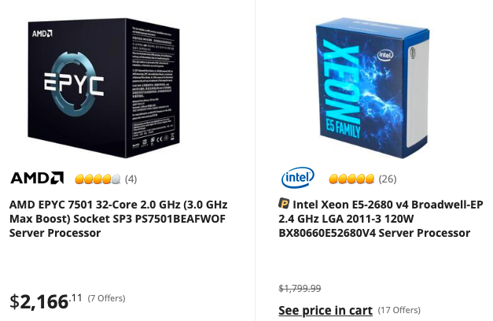
Computer hardware under the cover
Major components
of a computer
Input/Output devices
CPU
Memory
Network card
Solid state vs magnetic disk
LCD monitor
(various brands)
16GB for $100

Slide 8

Teardown of a packaged computer

Slide 9
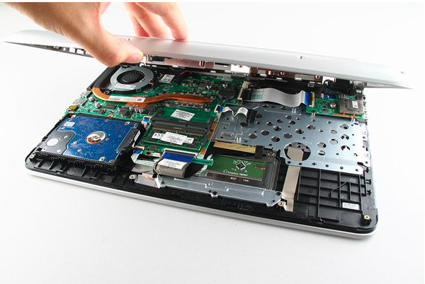
Teardown of a packaged computer

Slide 10
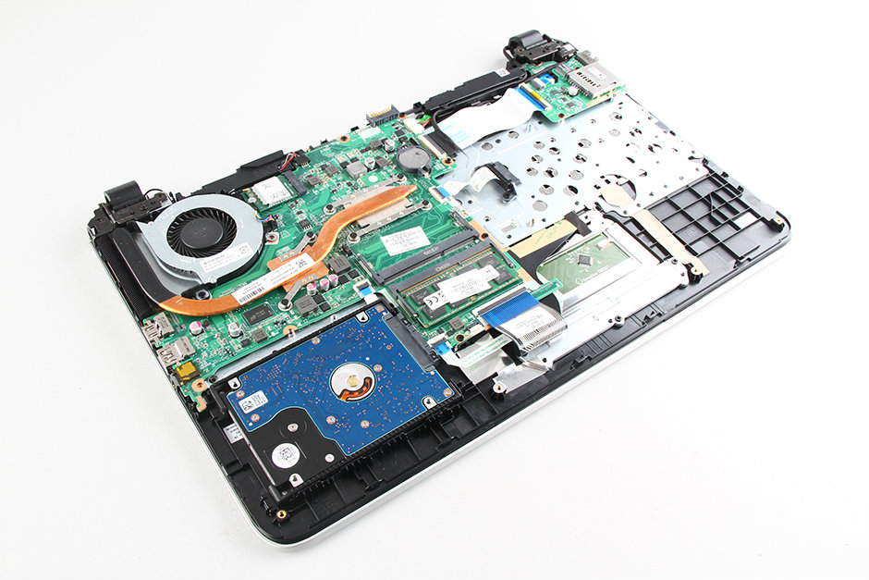
Teardown of a packaged computer
If you peel away that fan….
heat sink and cooling fan

Slide 11
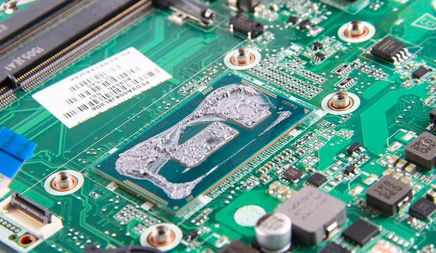
Teardown of a packaged computer
Thermal paste makes the CPU hard to see
Intel® Core™ i7-5500U 3GHz processor

Slide 12
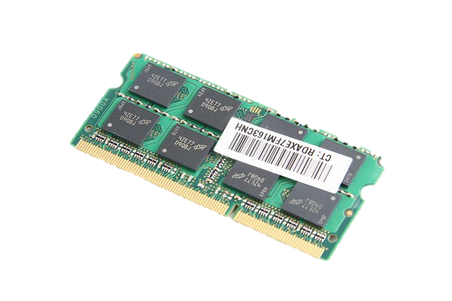
Teardown of a packaged computer
Micron 8GB memory

Slide 13
Teardown of a packaged computer
Hard-drive

Slide 14
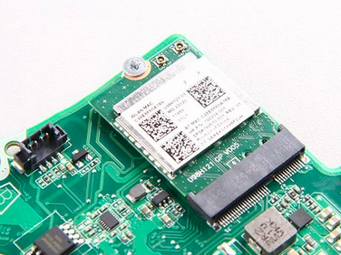
Teardown of a packaged computer
Wireless card

Slide 15
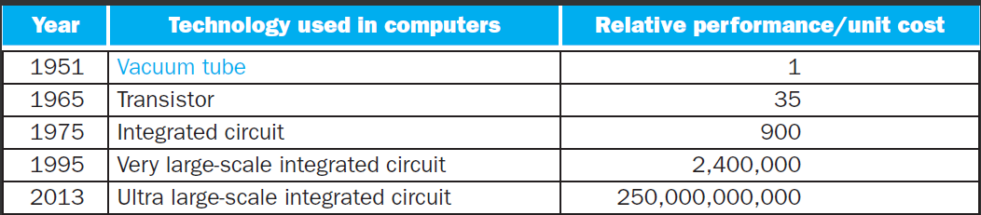
Technological trend: exponential growth
An off/off switch controlled by electricity
Combine numerous transistors on a single chip
CSO will focus on CPU and memory

Slide 16
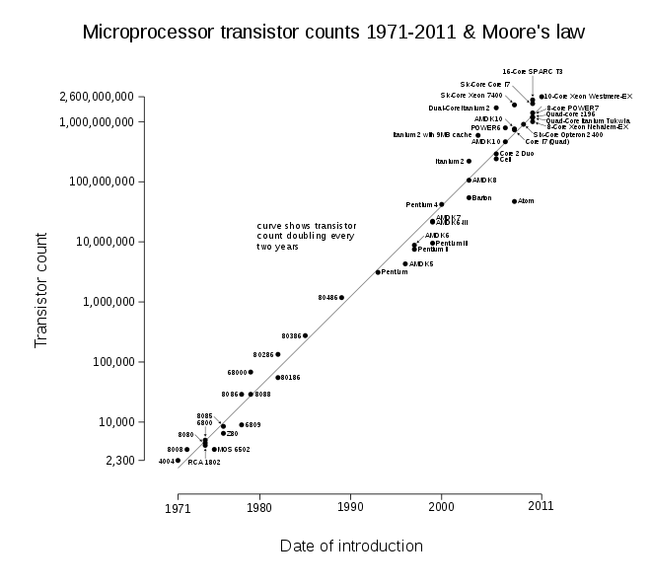
Moore’s Law in CPU
Moore’s Law:
Transistor count
doubles every 2 years

Slide 17
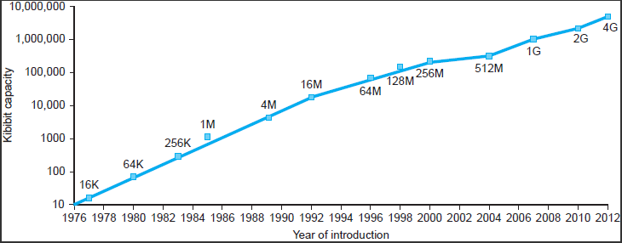
Moore’s Law in memory

Slide 18
Today’s lecture plan
Computer Hardware Basic
CPU, memory, I/O devices
Moore’s law
Basics of Logic design

Slide 19
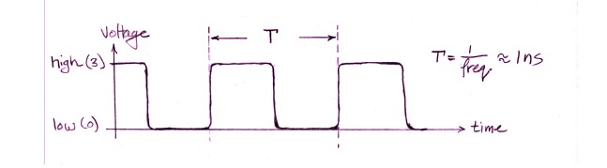
Digital Computer
Operate with only two voltage levels: high/low
that’s why computers work with binary numbers
The clock signal
“heartbeat” of the system

Slide 20
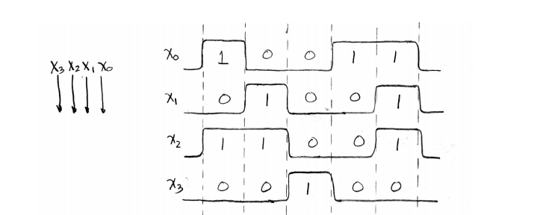
Digital Signals
Clock

Slide 21
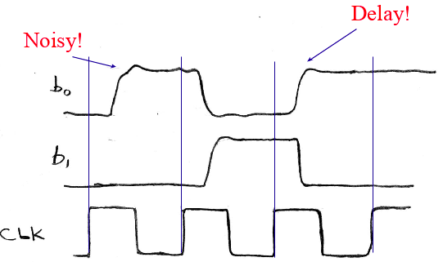
Digital signals

Slide 22
Basic element of implementation: switches
A
Z
Close switch (if A is “1” or asserted) → light bulb is on (Z)
Z
A
Open switch (if A is “0” or unasserted) → light bulb is off (Z)
Z ≡ A

Slide 23
Basic element of implementation: switches
Compose switches into more complex ones (Boolean functions):
A
B
AND
Z ≡ A and B
A
OR
Z ≡ A or B
B
Modern digital systems are done in CMOS transistors

Slide 24
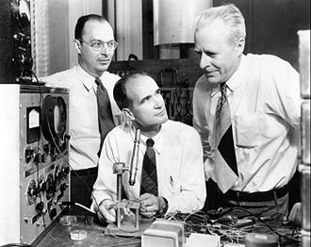
Transistors act as switches
Modern digital systems are implemented using CMOS transistors
MOS transistors act as voltage-controlled switches
Bardeen, Shockley and Brattain at Bell Labs, 1948

Slide 25
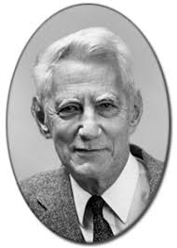
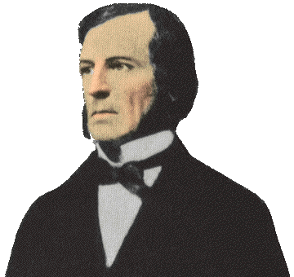
Historical Note
Early computer are built from ad hoc circuits
Common patterns emerge: ANDs, ORs, …
Claude Shannon made the link to work of 19th century mathematician George Boole
Called it “Boolean” in his honor
Shannon
Boole

Slide 26
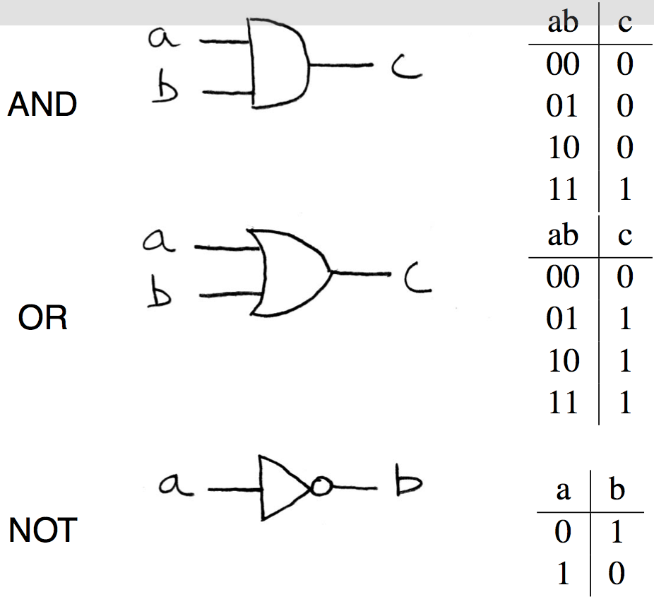
Gates: building blocks made from small groups of transistors

Slide 27


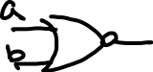
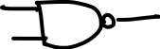
More gates
a
XOR
c
b
NAND
NOR

Slide 28


Boolean Algebra
Express (logic) functions with (logic) equations
A•B (AND), A+B (OR), Ā (NOT)
Laws of Boolean algebra:
Basic:
Inverse:
Commutativity:
Associativity:
Distribution:

Slide 29





Boolean Algebra

Slide 30
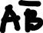
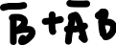
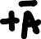
Boolean Algebra
Method 1: Compare Truth Table

Slide 31
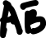
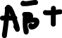
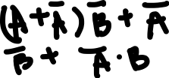
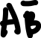
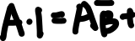

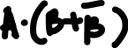
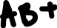
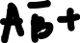
Boolean Algebra
Method 2: Simplify using basic laws

Slide 32

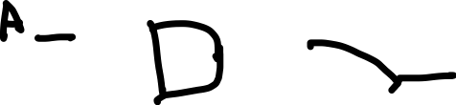
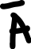
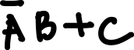
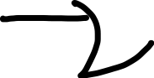

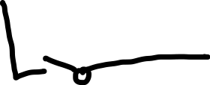

Logic circuits == Boolean algebra
What is the Boolean expression?

Slide 33


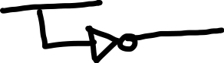
Logic circuits == Boolean algebra
What is the Boolean expression?

Slide 34
Two types of logic circuit
Combinatorial circuit
output is dependent only on the input
Sequential circuit
output is dependent on both input and state (memory)

Slide 35
How to implement any CL
Implement a function with AND/OR/NOT
E.g.: Count # of 1’s in 3-bit inputs
Step1: obtain truth tables

Slide 36

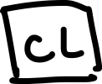


How to implement any CL
Implement a function with AND/OR/NOT
E.g.: Count # of 1’s in 3-bit inputs

Slide 37
How to implement any CL
Implement a function with AND/OR/NOT
E.g.: Count # of 1’s in 3-bit inputs

Slide 38
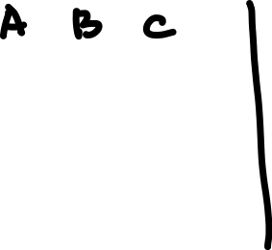
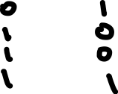
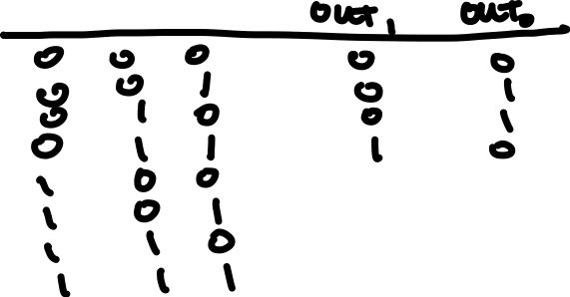
How to implement any CL
Implement a function with AND/OR/NOT
E.g.: Count # of 1’s in 3-bit inputs
Step 1: Write truth table

Slide 39


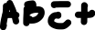
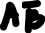
How to implement any CL
Implement a function with AND/OR/NOT
E.g.: Count # of 1’s in 3-bit inputs
Step 2: Find sum of product

Slide 40

How to implement any CL
A
B
C

Slide 41
How to implement any CL
Implement a function with AND/OR/NOT
E.g.: Count # of 1’s in 3-bit inputs
Step 2: Find sum of product

Slide 42
How to implement any CL
A
B
C

Slide 43
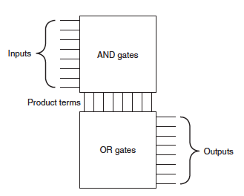
PLA (Programmable Logic Array)

Slide 44
Common CL: decoder
a1 | a0 | out3 | out2 | out1 | out0
0 | 0 | 0 | 0 | 0 | 1
0 | 1 | 0 | 0 | 1 | 0
1 | 0 | 0 | 1 | 0 | 0
1 | 1 | 1 | 0 | 0 | 0
out3
out2
decoder
out1
out0
2

Slide 45
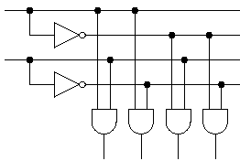
Common CL: decoder
a1
out3
out2
decoder
out1
a0
out0
2
out3
out2
out1
out0

Slide 46
Common CL: Multiplexor
Select among a set of inputs based on control
s1 | s0 | in3 | in2 | in1 | in0 | out
0 | 0 | x | x | x | 0 | 0
0 | 0 | x | x | x | 1 | 1
0 | 1 | x | x | 0 | x | 0
0 | 1 | x | x | 1 | x | 1
1 | 0 | x | 0 | x | x | 0
1 | 0 | x | 1 | x | x | 1
1 | 1 | 0 | x | x | x | 0
1 | 1 | 1 | x | x | x | 1
in3
in2
out
Mux
in1
in0
2
S

Slide 47
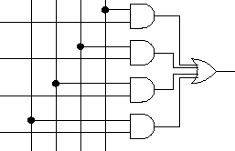
Common CL: Multiplexor
Select among a set of inputs based on control
s1
s0
decoder
in3
in2
out
in3
Mux
in1
in2
out
in0
in1
2
in0
S

